Slide 1
Data Lake & One Lake
Vraj Suratwala
BI
Department of ICT, VNSGU

Slide 2
Introduction to Data Storage & OneLake
Data Storage refers to the methods and technologies used to store, manage, organize, and retrieve data for operational and analytical purposes.
Organizations generate data from many sources:
Databases
Applications
Websites
IoT devices
Social media
Files and documents
Business applications
Sensors and machines
The storage system must be able to handle different volumes, formats, and types of data.

Slide 3
Types of Data
Before understanding Data Lakes, remember the three broad categories of data.
1. Structured Data
Data with a fixed schema and well-defined structure.
Examples:
SQL tables
Customer records
Sales transactions
Customer_ID | Name | City
101 | Vraj | Surat
102 | Rahul | Mumbai

Slide 4
Types of Data
2. Semi-Structured Data
Data that does not follow a strict tabular structure but contains some organizational information such as tags, keys, or metadata.
Examples:
JSON
XML
CSV
Web logs
Example: {
"CustomerID": 101,
"Name": "Vraj",
"City": "Surat"
}

Slide 5
Types of Data
Data without a predefined tabular structure.
Examples:
Images
Videos
Audio
PDFs
Text documents
Emails
⭐ Exam Point
Data Lake is particularly useful because it can store structured, semi-structured, and unstructured data.

Slide 6
Traditional Data Storage
Traditionally, organizations stored data in systems such as:
Relational Databases
Used primarily for structured data.
Examples:
SQL Server
MySQL
Oracle
PostgreSQL

Slide 7
Data Warehouses
Designed mainly for analytical processing and reporting.
Operational Systems
↓
ETL
↓
Data Warehouse
↓
Reports / BI
However, modern organizations generate huge amounts of diverse data that may not fit naturally into traditional relational systems. This led to the growth of Data Lakes.

Slide 8
Evolution of Data Storage
A simple evolution can be remembered as:
Files / Databases
↓
Data Warehouse
↓
Big Data Platforms
↓
Data Lake
↓
Modern Unified Data Platforms
↓
OneLake
Why did Data Lakes emerge?
Traditional data warehouses generally expect structured, modeled data.
But organizations started dealing with:
Huge + Diverse + Rapidly generated data
Therefore, organizations needed storage that was:
Highly scalable
Cost-effective
Flexible
Capable of storing raw data
Suitable for different data formats
This is where Data Lakes became important.

Slide 9
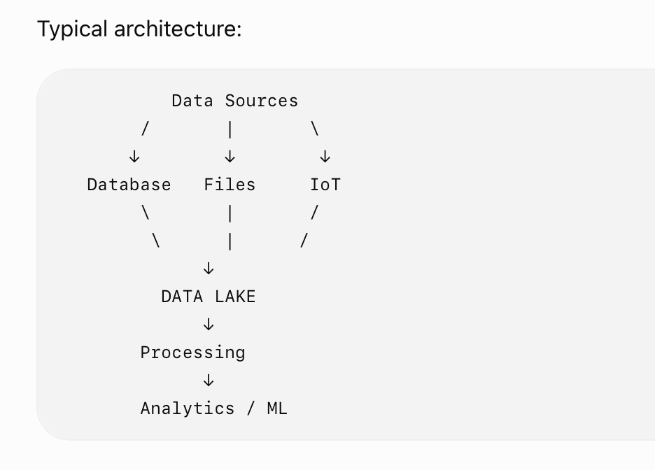
What is Data Lake ?
A Data Lake is a centralized repository designed to store large volumes of data in its original or raw form, including structured, semi-structured, and unstructured data.
Simple Definition
Data Lake = Centralized storage for large amounts of diverse data, often kept in its original form until needed for processing.

Slide 10
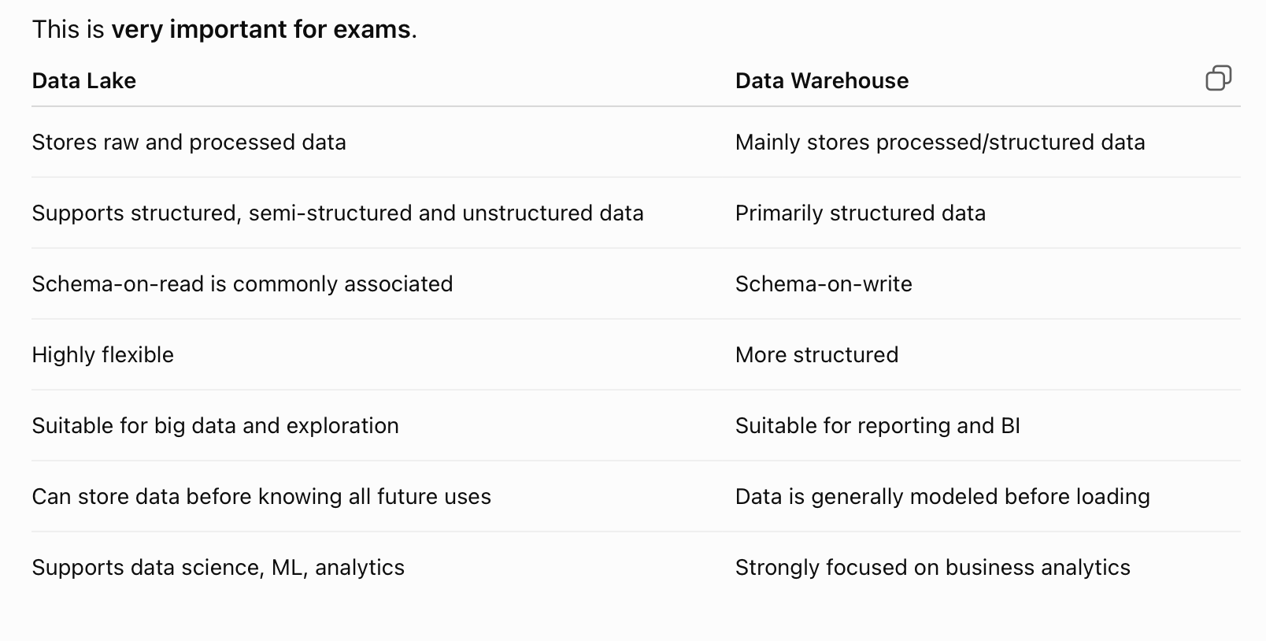
Data Warehouse vs Data Lake

Slide 11
Introduction to Microsoft OneLake
Now we come to the important part of this unit.
OneLake is the single, unified, logical data lake for an organization within Microsoft Fabric.
Microsoft describes OneLake as a centralized data lake designed to eliminate data silos and provide a common storage layer for Fabric workloads.
Simple Definition
OneLake is a unified, organization-wide data lake that serves as the central storage foundation for Microsoft Fabric.

Slide 12
Need of OneLake
In a traditional organization, different teams may maintain separate storage systems:
Sales → Data Lake A
Finance → Database B
Marketing → Data Lake C
HR → Storage D
This can create:
Data duplication
Data silos
Multiple copies of the same data
Increased storage requirements
Difficult data governance
Complex data management

Slide 13
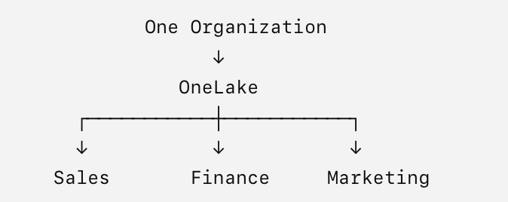
Aim of OneLake

Slide 14
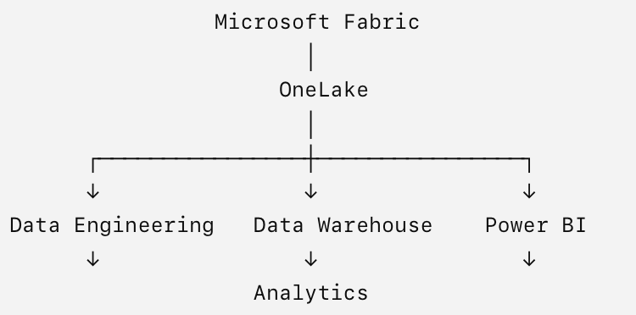
OneLake and Microsoft Fabric
OneLake is a fundamental component of Microsoft Fabric.
Fabric provides multiple workloads, such as:
Data Engineering
Data Factory
Data Science
Data Warehouse
Real-Time Intelligence
Power BI
These workloads can work with data stored in OneLake.

Slide 15
Characteristics
1. Single Storage Layer
2. Built into Microsoft Fabric
3. Supports Different Data Types
4. Reduces Data Silos
5. Centralized Governance
6. Avoids Unnecessary Data Duplication

Slide 16
OneLake Shortcuts
Shortcuts are an important OneLake concept.
A shortcut provides a way to reference data stored in another location without physically copying the data into OneLake.
Conceptually:
External Data
│
│ Shortcut
↓
OneLake
This can help reduce:
Data duplication
Data movement
Storage costs
Data integration complexity
OneLake shortcuts provide access to data in external storage without requiring a traditional physical copy of the data.

Slide 17
One Copy of Data Concep
OneLake promotes the idea of "one copy of data" rather than maintaining multiple copies for different analytics tools.
Traditional approach:
Source Data
├── Copy → BI
├── Copy → Data Science
├── Copy → Warehouse
└── Copy → ML
OneLake approach:
ONE COPY
↓
OneLake
/ | \
↓ ↓ ↓
BI ML Analytics
This helps create a more unified data environment.

Slide 18
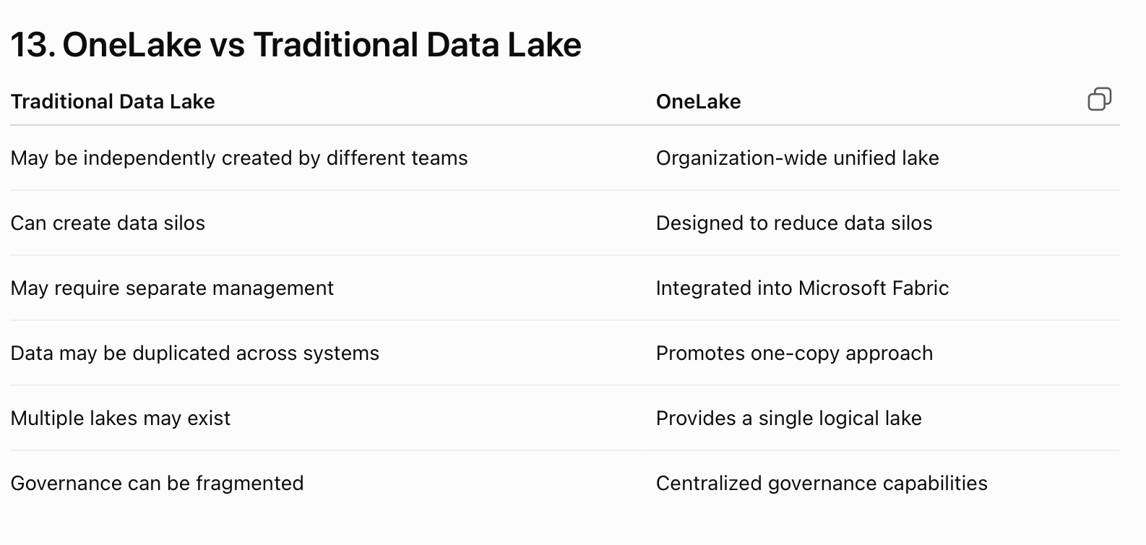
Comparision Table

Slide 19
Data Ingestion & INtegration with OneLake
Included Data Ingestion Methods
BI

Slide 20
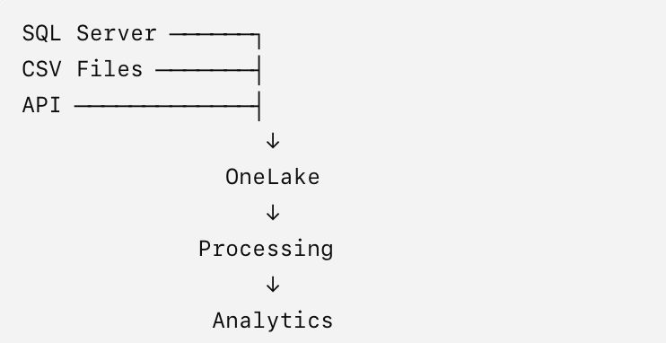
What is Data Ingestion?
Data Ingestion is the process of collecting and bringing data from different sources into a storage system such as OneLake.
In simple words:
Data Ingestion = Getting data from source systems into OneLake.
Sources may include:
Databases
Files
Applications
APIs
Cloud storage
IoT systems

Slide 21
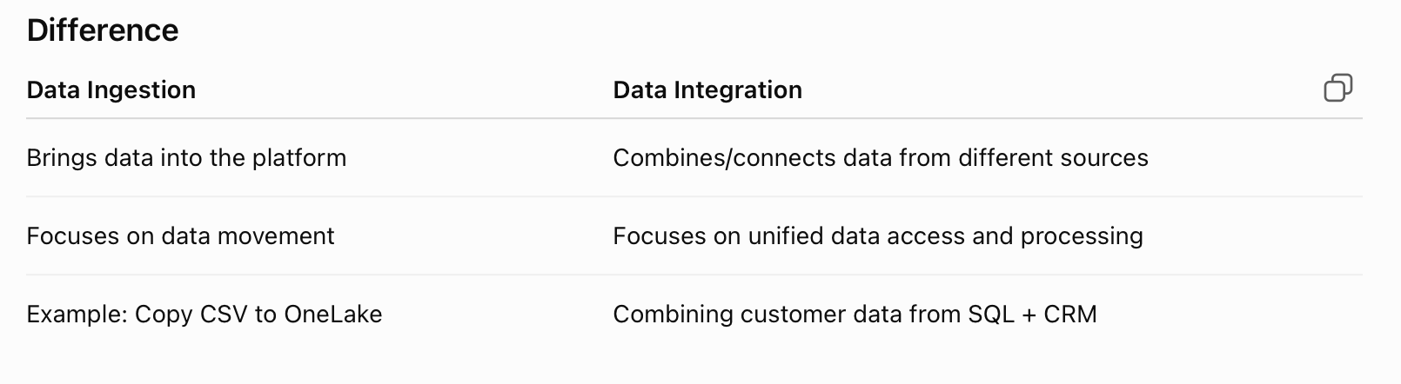
What is Data Integration?
Data Integration is the process of combining data from different sources and making it available in a unified environment.

Slide 22
3. Data Ingestion into OneLake
In Microsoft Fabric, data can be brought into OneLake using different methods.
Two important methods in your syllabus are:
Copy Activity in Data Factory
Spark Notebook
Copy Activity in Data Factory : Copy Activity is a data movement activity used to copy data from a source to a destination.
In Microsoft Fabric, Data Factory provides data integration capabilities, including pipelines and Copy Activity.

Slide 23
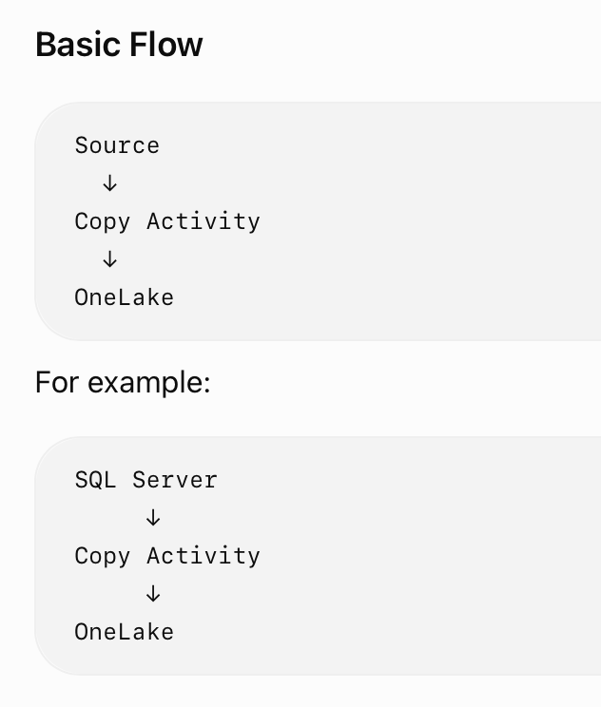
Basic Flow Diagram

Slide 24
How Copy Activity Works ?
Step 2 — Select Destination
The destination is where the data will be copied.
For this topic:
OneLake / Fabric Lakehouse
A basic Copy Activity involves:
Step 1 — Select Source
The source is where the data currently exists.
Examples:
SQL Server
Azure SQL Database
CSV
Excel
Other supported data sources

Slide 25
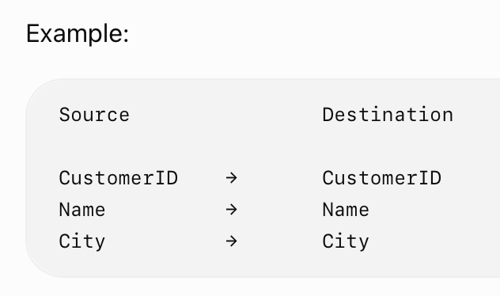
Cont..
Step 3 — Configure Mapping
Source columns can be mapped to destination columns.
Step 4 — Execute Pipeline
The Copy Activity reads data from the source and writes it to the destination.

Slide 26
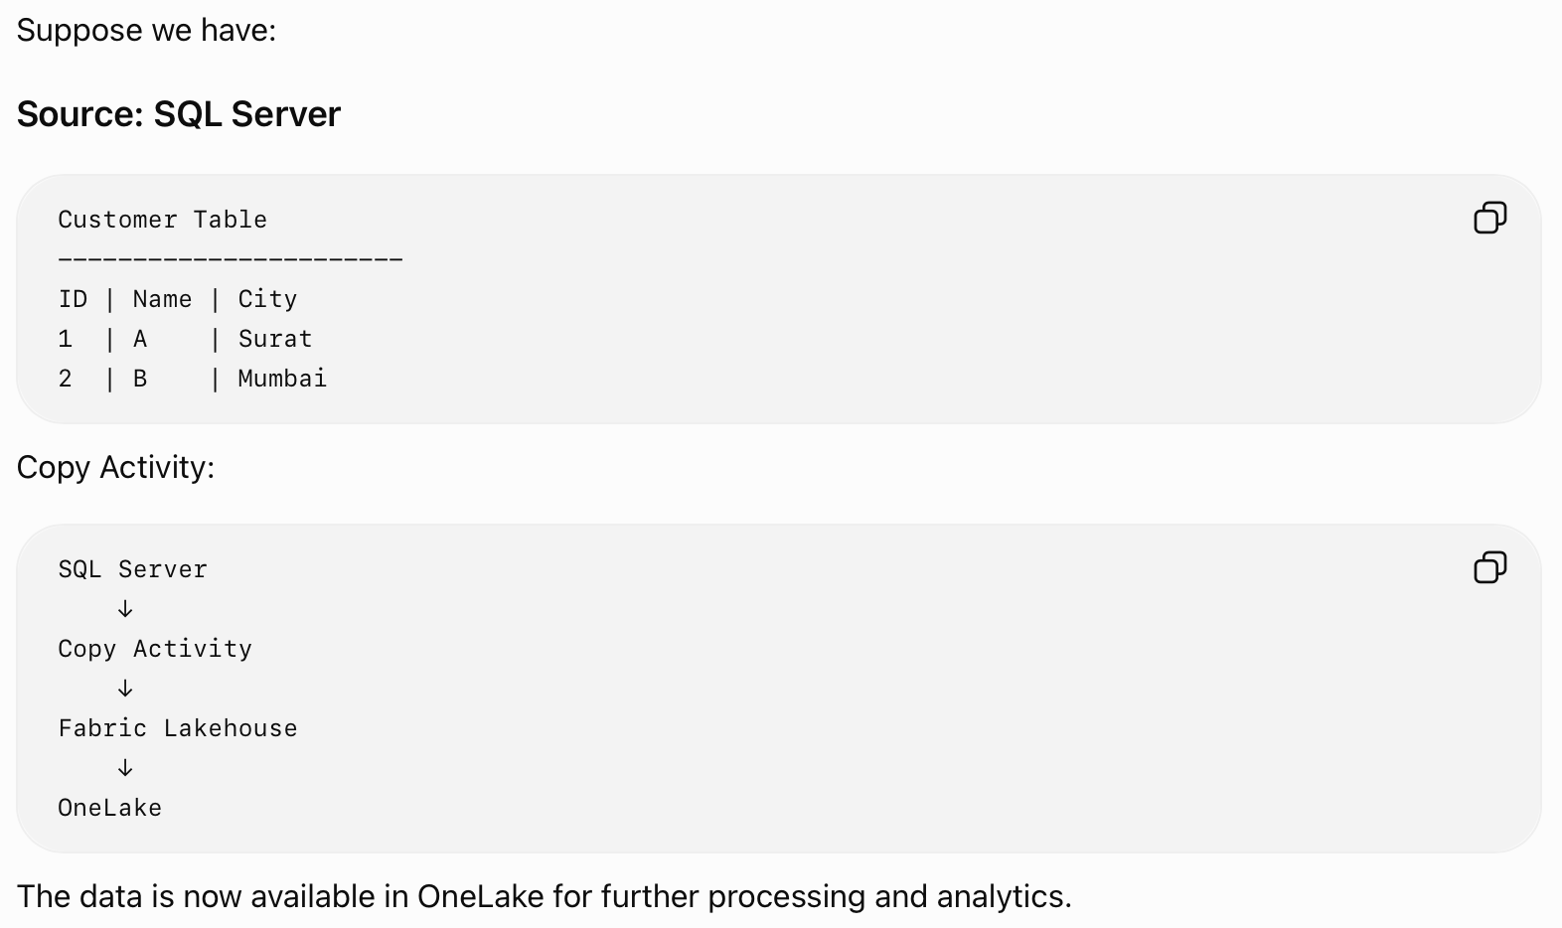
Example : Copy Activity

Slide 27
Advantages : Copy Activity
Simple data movement
Supports many data sources and destinations
Can be used in pipelines
Supports column mapping
Useful for scheduled/automated ingestion
Suitable for bulk data movement
Can be combined with other pipeline activities

Slide 28
Spark Notebook : Basic Usage
Spark Notebook provides an interactive environment where developers can use Apache Spark to read, process, transform, and write data.
In Microsoft Fabric, Spark notebooks can work with data stored in OneLake.
Data Source / OneLake
↓
Spark Notebook
↓
Read / Process / Transform
↓
OneLake

Slide 29
Basic Spark Notebook Operations
For your syllabus, remember only the basic usage.
A Spark Notebook can be used to:
Read data
Process data
Transform data
Write data back to OneLake
Example :
CSV / Lakehouse Table
↓
Spark Read
↓
DataFrame
↓
Transformation
↓
Write Data
↓
OneLake

Slide 30
Spark DataFrame
A DataFrame is a distributed data structure used by Spark to work with structured data.
Example concept:
Customer Data
↓
Spark DataFrame
↓
Filter / Select / Transform
↓
Output
For example, you could filter customers from Surat:
City == "Surat"
and write the resulting data back to OneLake.

Slide 31
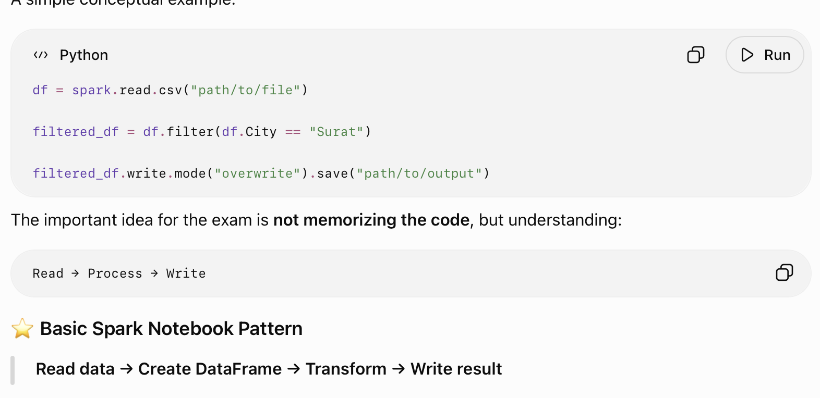
Basic Spark Notebook Example

Slide 32
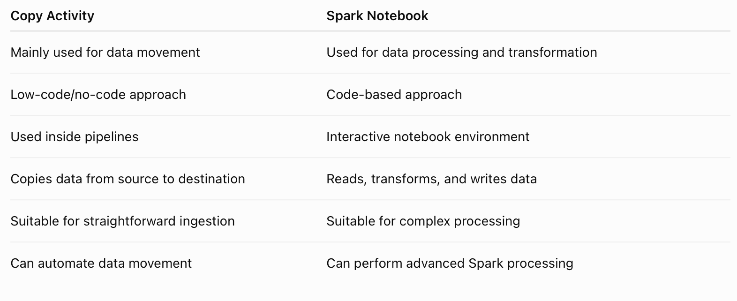
Comparision

Slide 33
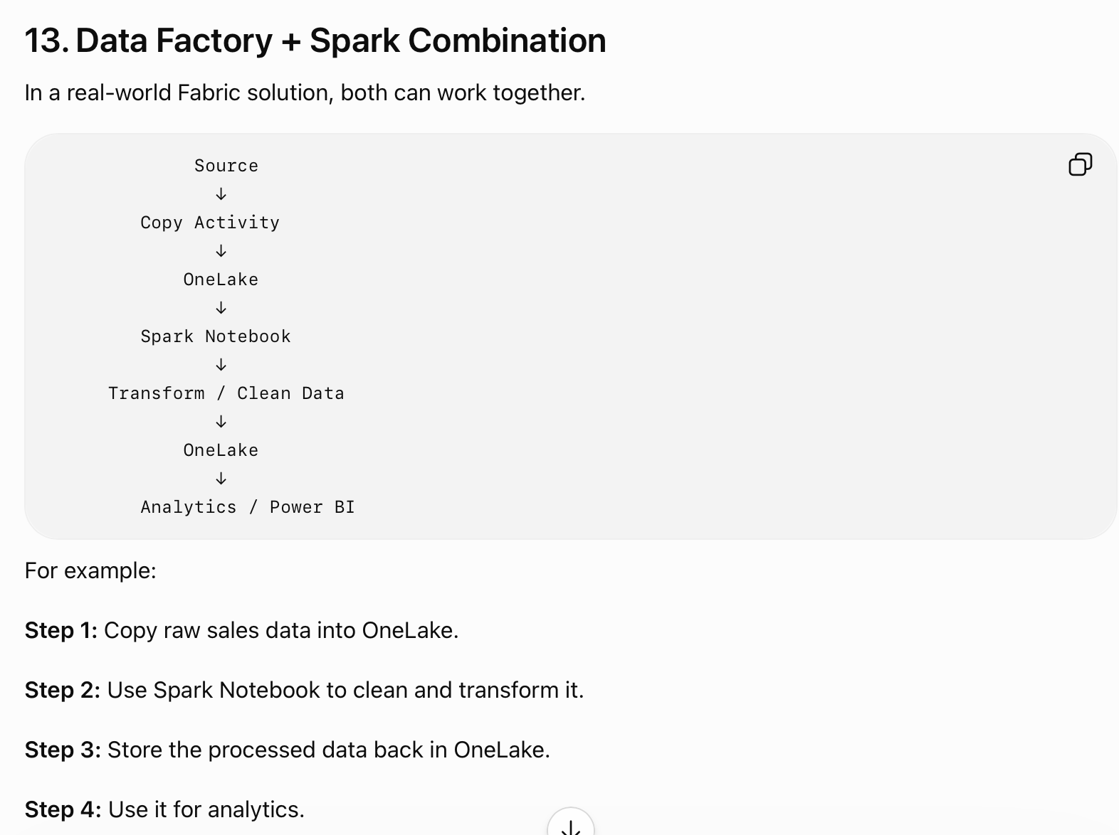
REAL - WORLD EXAMPLE

Slide 34
Thank You
Vraj Suratwala
BI
Department of ICT, VNSGU

